Slide 1
Preliminary Presentation

Slide 2
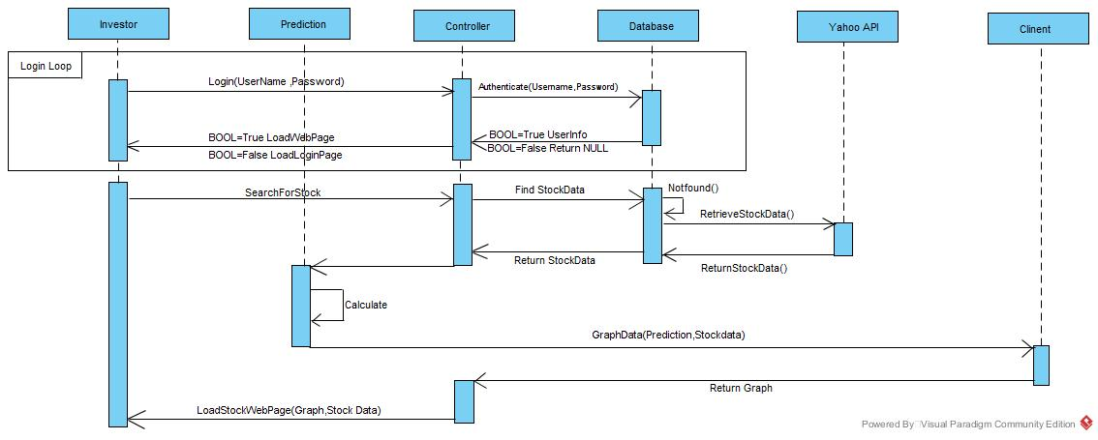
High-Level Architecture

Slide 3
Web Sources
The original link of stock from Yahoo is http://finance.yahoo.com/q?s=YHOO, however we use the following URL as http://finance.yahoo.com/d/quotes.csv?s=$stock&f=$format, where parameters $stock and $format simply reflects stock symbol and fetched symbol. Moreover, we can realize various data collection by different parameters such as
http://finance.yahoo.com/d/quotes.csv?s=GOOG+AAPL+MSFT&f=snl1d1t1cv
where s=symbol, n=name,|1=last trade, d1=last trade due ,t1=last trade time, c=change and percent change, v=volume. The above URL will fetch stock data of Google, Apple, Microsoft and Yahoo.

Slide 4
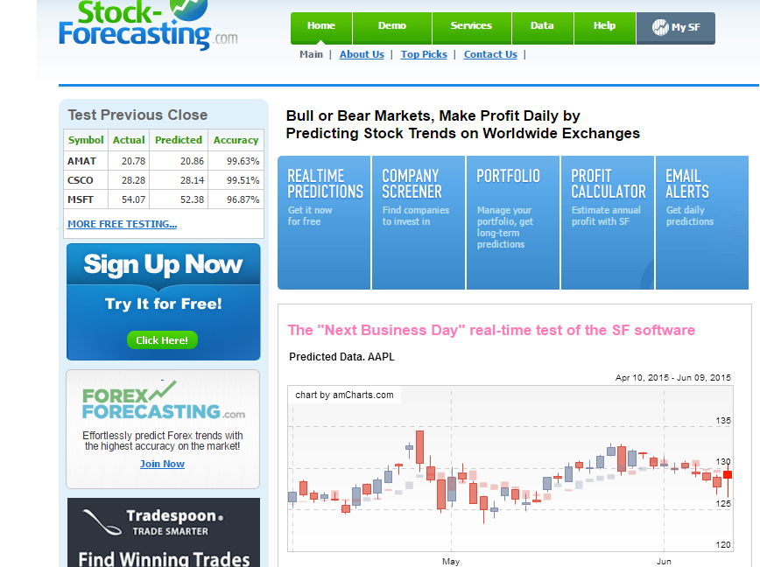
Similar Systems
Stock-forecasting.com
customizable charts
Real-time prediction
Stock alerts- reactive and informative

Slide 5
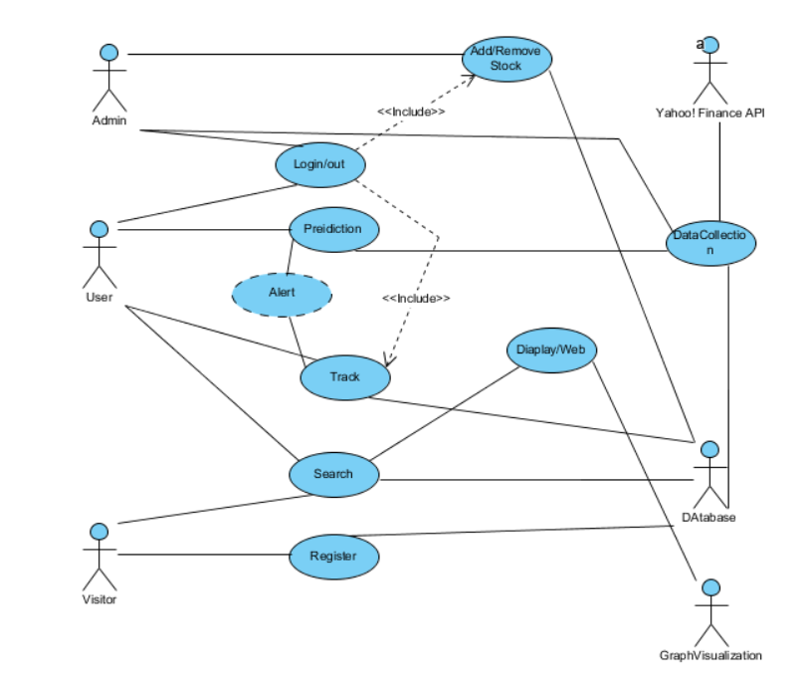
Use Case

